Slide 1

PUTTING IT ALL BACK TOGETHER
Anabolic Pathways

Slide 2
Section One: Organization of Anabolic Pathways

Slide 3
Control of Anabolic
Insulin:
  Tyrosine Kinase second messenger
Parasympathetic System:
  cGMP second messenger

Slide 4
As soon as you eat…You replenish your plasma glucose
Incretins Dipeptidyl peptidase
Exenatide Saxagliptin
Liraglutide Sitagliptin
Dulaglutide Vildagliptin
After glucose returns to the liver…You turn off gluconeogenesis
After you turn off gluconeogenesis…You turn on glycogen synthesis

Slide 5
Block Alpha 1 Glucosidase
Acarbose
Miglitol
Both limit the absorption of glucose from the GI tract

Slide 6
Incretins
Physiologic: GLP 1
Made in the duodenum
Inhibit Glucagon
Increase Insulin secretion
This signal is decreased in diabetics
This signal is blocked by Dipeptidyl peptidase

Slide 7
Block Gluconeogenesis
Phenformin
Metformin
  Causes lactic acidosis
  Interacts with IV contrast to destroy the kidneys
  For elective procedures: Stop the drug
    Wait 48 hours, then do the procedure
  For emergency procedures: Hold the drug
    Run plenty of normal saline
    Give N-Acetylcysteine as antioxidant

Slide 8
Section Two: Anabolic Pathways

Slide 9
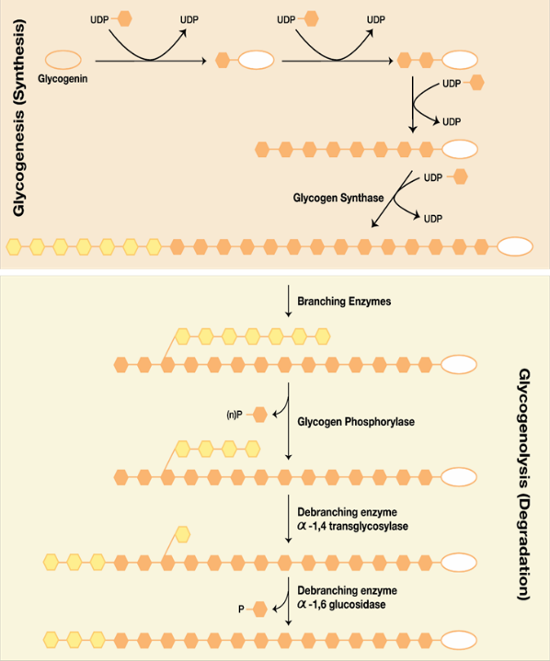
Glycogen Synthesis
Figure 6.1 Glycogen Synthesis, Steps 1-8

Slide 10

Glycogen Synthesis
Figure 6.2 Glycogen Synthesis, Steps 9-12

Slide 11
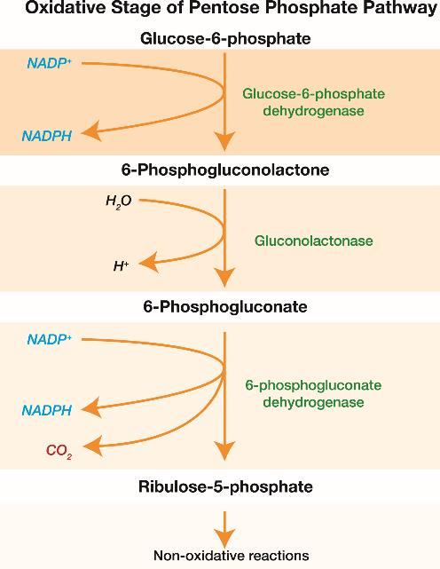
Pentose Pathway
Figure 6.3 Pentose Pathway

Slide 12
NADPH is used for…
Fatty acid synthesis
DNA synthesis
RBC repair (used by glutathione)

Slide 13
X-linked Recessive Enzymes
G6PD
Fabry’s (alpha galactosidase)
Hunter’s (Iduronidase)
CGD (NADPH Oxidase)
Lesch-Nyhan (HGPRT)
Adrenoleukodystrophy (CAT-1)
Adenosine Deaminase (SCID) 2/3
Ornithine Transcarbmylase
PRPP Synthetase
Tyrosine Kinase

Slide 14
G6PD
More common in Mediterranean's (protects them from malaria)
Mcc of hemolytic crisis: (1) infection (2) drugs
Drugs that oxidize RBC’s: sulfa drugs; antimalarials; metronidazole; INH
Heinz bodies

Slide 15
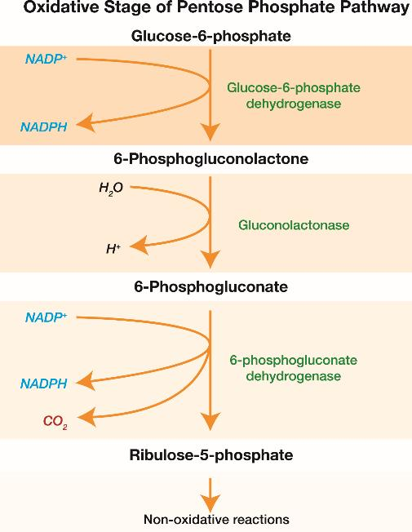
Pentose Pathway
Figure 6.3 Pentose Pathway

Slide 16
Nonoxidative Pentose Pathway
Transketolase
  Uses TPP as cofactor
  Uses Vitamin B1
  Decarboxylates
Transaldolase
  Uses PLP as cofactor
  Uses Vitamin B6
  Decarboxylates

Slide 17
Wernicke’s Encephalopathy
Wernicke’s area in posterior temporal lobe
Symptoms due to increased ICP:
  Nausea, vomiting, dysarthria, double vision, headache, ataxia, etc.
Always give 100mg of Thiamine prior to giving any sugar to patient
Wernicke’s Aphasia: Area is dead

Slide 18
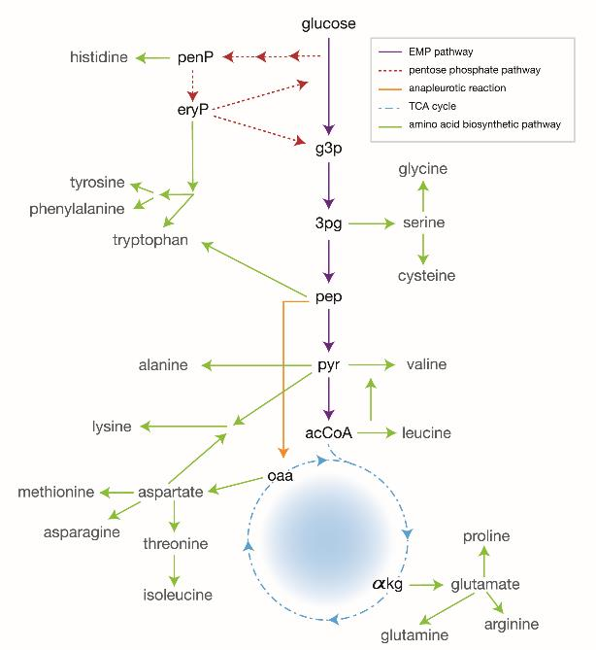
Amino Acid Synthesis
Figure 6.5 Amino Acid Synthesis

Slide 19
Transaminases
All use vitamin B6
AST: one in cytoplasm, one in mitochondria
  Does 50% in cytoplasm; does 10% in mitochondria
ALT: One in cytoplasm
  Does 50% in cytoplasm
GGT: One in mitochondria
  Does 90% in mitochondria

Slide 20
GGT
Amino acid + alpha ketoglutarate = glutamate + carbons

Slide 21
Where Amino Acids Are Made
Pyruvate
Acetyl-CoA
Alpha Ketoglutarate
Succinyl-CoA
Fumarate
Oxaloacetate

Slide 22
Succinyl-CoA
Used to make ringed structures

Slide 23
Hepatitis
AST and ALT are one-to-one, except in alcohol
Alcohol liver damage: AST/ALT ratio is 2 to 1 or GGT is elevated

Slide 24
To Stop the TCA Cycle:
Too much NADH
Block three important enzymes:
  Pyruvate Dehydrogenase
  Isocitrate Dehydrogenase
  Alpha Ketoglutarate dehydrogenase

Slide 25
Citrate Shuttle
Brings acetyl-CoA units out to the cytoplasm
Citrate:
  Blocks PFK 1
  Activates Acetyl-CoA carboxylase
  Delivers Acetyl-CoA units to fatty acid synthesis

Slide 26
AcCoA +ATP + CO2 = Malonyl-CoA AcCoA Carboxylase
This is done each round

Slide 27
To Make Palmitic Acid:
How many rounds: #C/2 – 1
How many NADPHs: #C – 2
How many ATPs: #C - 1

Slide 28
Pyruvate Carboxylase
The Anapleurotic enzyme
  Its product is an intermediate of TCA cycle

Slide 29
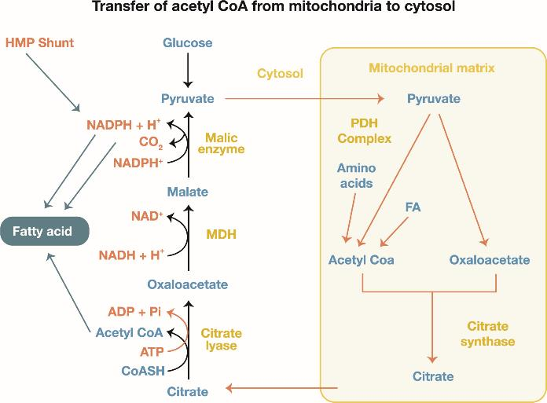
Fatty Acid Synthesis
Figure 6.6 Fatty Acid Synthesis

Slide 30
Fatty Acid Synthase
The largest quaternary enzyme ever discovered in biochemistry
Requires ten steps to complete reaction, but only four of them are important:

Slide 31
1. Malonyl-CoA Attacks an Even Number of Carbons
O O O O
C - C – C – C – CSCoA + C – CSCoA
O

Slide 32
2. Decarboxylation
O O O
C - C – C – C - CSCoA
O
O O
CO₂ + C - C – C – CSCoA

Slide 33
3 & 4. Add Protons to Inside Ketone
HOH O
C - C – C – CSCoA
O
C - C – C – CSCoA
+ H₂O

Slide 34
Palmitic Acid
The main fatty acid that we make every day
Saturated FA: No double bonds
Unsaturated FA: has double bonds
Omega FA: counting carbons from the right side
  Omega 3 FA: Decreases serum cholesterol
  Policosanol

Slide 35
Rules for Fatty Acids
We do NOT go beyond C-16
Double bonds must be at least 3 carbons apart
NO double bonds after C-10
C₁₆ 2(1,10)
C = C-C-C-C-C

Slide 36
Essential Fatty Acids
Linolenic
Linoleic (used to make arachidonic acid)
Come ONLY from the diet
Your body can not make these

Slide 37
Arachidonic Acid
Cyclooxygenase
  PGA₂
  PGE₂
  PG1₂
  PGF₂
Lipoxygenase
  LTB₄
  LTC₄D₄E₄
  (SRS-A)

Slide 38
From Arachidonic Acid:
Cyclooxygenase:
  COX 1 and COX 2
  Makes prostaglandins
Lipoxygenase:
  Makes leukotrienes

Slide 39
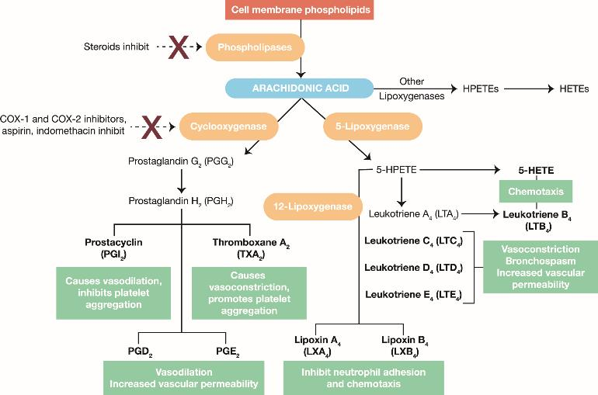
Arachidonic Acid
Figure 6.9 Arachidonic Acid Pathway

Slide 40
Steroid Use in Asthma
Decreased deaths
Decreased hospitalizations
Decreased oxygen use
Decreased ICU use

Slide 41
Aspirin-Sensitive Asthma
Blocking COX shunts intermediates towards Lipoxygenase
Leukotrienes are more severe bronchoconstrictors
Patient has nasal polyps

Slide 42
SRS-A (Slow Reacting Substance of Anaphylaxis)
LT C4,D4,E4
Produced by mast cells
Released 4 to 8 hours after initial allergic response
A potent Broncho(Vaso)constrictor
Destroyed by Arylsulfatase

Slide 43
Metachromatic Leukodystrophy
Arylsulfatase deficiency
Multiple sclerosis equivalent in a 5 to 10 y/o child

Slide 44
LT B4
Strong chemoattractant for neutrophils
IL 8 also
Minor players: C3a and C5a

Slide 45
Thromboxane (PG A2)
Vasoconstricts
Decreased platelet aggregation
This is the target of Aspirin

Slide 46
PG E-2 (E-1)
Vasodilates: 80% Vasoconstricts: 20%
Keeps PDA open
Maintains stomach protection
Dilates the renal afferent arteriole

Slide 47
PDA
Alprostadil (PG E analogue) opens the PDA
Indomethacin closes the PDA

Slide 48
Aspirin/NSAID Induced Ulcers
Misoprostol: puts prostaglandin back
Or use COX 2 inhibitors

Slide 49
COX 2 Inhibitors
Celecoxib
Rofecoxib
Valdecoxib
Creates cardiovascular risk by blocking prostacyclins

Slide 50
Prostacyclin
Made by endothelium
Vasodilates
Inhibits platelet aggregation
Used to treat pulmonary hypertension
Made primarily by COX 2

Slide 51
PG F-2
Vasoconstrictor
Involved in painful menstrual cramps
Separates placenta after fetus is delivered
Hi levels in semen

Slide 52
PG E-2 Analogues
Misoprostol
Alprostadil
Dinoprostone

Slide 53
PG F-2 Analogues
Arborist
Latanoprost

Slide 54
Leukotrienes

Slide 55
Leukotrienes: LT- C4,D4,E4
AKA: SRS-A (slow reacting substance of anaphylaxis)
Made by mast cells 4 to 8 hours after allergic response (late symptoms)
The most potent bronchoconstrictor

Slide 56
LT B-4
Strong chemoattractant for neutrophils
IL 8 also

Slide 57
Pharmacology

Slide 58
Irreversible Cyclo-Oxygenase Inhibitor
Aspirin
  Antiplatelet
  Antipyretic
  Anti-inflammatory
  Analgesia

Slide 59
Acid Base Problems From Aspirin
Initial: Respiratory alkalosis
  pH –high pCO2 – low HCO3 – nl
Most common: Combined metabolic acidosis and respiratory alkalosis
  pH – almost nl pCO2 – low HCO3 – low
End stage: Mixed acidosis
  pH – low pCO2 – high HCO3 - low

Slide 60
Aspirin Overdose
Fluids first
Bicarbonate

Slide 61
Reversible Cyclo-Oxygenase inhibitors
NSAIDs
  Indomethacin
  Phenylbutazone
  Ibuprofen
  Naproxen
  Baclofen
  Ketorolac
  Diclofenac
  Ketoprofen
  Sulindac

Slide 62
Steroids
Anti-inflammatory actions
  Inhibit PLP-A
  Kills T-cells and eosinophils
  Inhibits macrophage migration
  Stabilizes mast cells
  Stabilizes endothelium
Physiologic actions
  Proteolysis
  gluconeogenesis

Slide 63
Steroids
Prednisone
Methylprednisolone
Triamcinolone
Budesonide
Ciclesonide
Beclomethasone
Betamethasone
Hydrocortisone
Dexamethasone
Fludrocortisone
Cyproterone
Megestrol
Fluticasone
Mometasone
Danazol

Slide 64
Mast Cell Stabilizers
Cromolyn
Nedocromil

Slide 65
Management of Asthma
Level 1: mild intermittent
  Use B-2 agonist as needed
Level 2: Mild Persistent
  Under age 5: cromolyn inhaler daily/B2 agonist prn
  Above age 5: steroid inhaler daily/B2 agonist prn
Level 3: Moderate persistent
  LABA/Steroid inhaler daily and use B2 agonist prn
Level 4: Severe
  Oral steroids: start w/ high dose, them taper
Level 5: Very Severe
  Add Omalizumab

Slide 66
LRBs
Zafirlukast
Montelukast
Zileuton

Slide 67
Triglyceride Synthesis
C
C
C-O-P
Glycerol 3 Phosphate

Slide 68
To Make Glycerol 3 Phosphate
Only the liver has glycerol kinase
All other organs use DHAP to make G-3 P

Slide 69
Lysophosphatidic Acid
Has a C-16 attached to carbon 1
  NO double bonds allowed on this carbon

Slide 70
Phosphatidic Acid
Has a fully saturated C-16 on carbon 1
Now has an unsaturated C-16 at carbon 2
Becomes the backbone for complex phospholipids

Slide 71
Carriers
CDP: the carrier for complex lipids
UDP: the carrier for one sugar donation
Dolichol: the carrier for multiple sugar donation

Slide 72
Phosphatidylethanolamine
Use for building receptors on neuronal tissue

Slide 73
Phosphatidylcholine
Used to make Lecithin
  Helps emulsify fats for digestion and absorption
Also used to make Surfactant
  Increases compliance of lungs
  Prevents collapse (Atelectasis) of airway

Slide 74
Phosphatidylserine
A marker for apoptosis
  Gene: P53
  Protein: D-Cyclins
  Label: phosphatidylserine
  Caspaces: recognize label and destroy the cell
  Ubiquitin: Label for proteins that need destruction
  Ubiquitin Ligase: Places label on proteins

Slide 75
Cardiolipin
Made with two G-3P back-to-back
A marker seen in SLE
  Stimulates intrinsic clotting cycle
  Multiple spontaneous abortions
  Blocks VWF
  Cause false VDRL

Slide 76
IP-3/DAG
DAG made by removing the phosphate group and adding an OH-group to carbon 3
Second messenger for all hypothalamic hormones except CRP
Second messenger for all smooth muscle contraction cause by hormone or neurotransmitter

Slide 77
Triglycerides
Made by removing the OH-group from DAG and adding another C-16 to carbon 3

Slide 78
Pancreatic Lipase
Helps digest dietary lipids
Inhibited by Orlistat
  Causes steatorrhea
  Cause Low volume state
  Loss of fat-soluble vitamins
  Affects steroid hormones

Slide 79
Lacteals
Lymphatic channels for lipid absorption

Slide 80
Ezetimibe
Blocks lacteals and lipid absorption
Same side effects as Orlistat

Slide 81
Triglyceride Transport
Chylomicrons
VLDL
IDL
Signs:
  Xanthelasma
  Pancreatitis

Slide 82
Chylomicrons
Made from Apo B-48
Carries long and short chain fatty acids
Drops off 75% of triglycerides to endothelium
Drops off remaining 25% of triglycerides to liver
Gets Apo C-2 from HDL
Uses Apo C-2 to activate Lipoprotein Lipase

Slide 83
Medium Chain Triglycerides
Do NOT use the chylomicrons
Carried by Albumin to liver
Do NOT require lacteals
Can be absorbed even in inflammatory bowel disease

Slide 84
VLDL
Made in the liver
Has 95% long chain free fatty acids, 5% cholesterol
Gets Apo B100 from the liver
Gets Apo C-2 and Apo E from HDL
Goes to Adipose to drop off 50% of triglycerides
Uses Apo C-2 to activate Lipoprotein Lipase
Blocked by Niacin

Slide 85
IDL
A remnant of VLDL
Has Apo C-2, Apo E, and Apo B100
Uses ONLY Apo E to drop off triglycerides everywhere else

Slide 86
To Treat Hypertriglyceridemia
The Fibrates: Enhance lipoprotein lipase activity
  Gemfibrozil
  Clofibrate
  Fenofibrate
If that is not enough, then add:
  Blocks VLDL production in liver
  Niacin
  Probucol

Slide 87
Sphingolipids
C₁₆-SCoA

Slide 88
CDP = carrier for complex lipids

Slide 89
Sphingosine
Made by adding CDP-serine to C-16SCoA

Slide 90
Ceramide
Made by adding C-16 to the N of serine on sphingosine
Becomes the backbone for the complex sphingolipids

Slide 91
Cerebroside
Made by adding a UDP-sugar to ceramide
Found in Myelin

Slide 92
Ganglioside
Made by adding a ‘gang’ of sugars to ceramide
Dolichol is the carrier for the sugars

Slide 93
Sphingomyelin
Made by adding phosphorylcholine to ceramide

Slide 94
The BIG Picture
All the complex lipids are used mainly by neural tissue
Therefore, all the syndromes have severe intellectual deficiency, microcephaly, poor milestones attainment, floppy babies, etc.
These large molecules are all recycled after they are used
Lysosomes digest them back to their small parts and they are recycled
Severe low energy state if not able to recycle due to deficiency of enzyme

Slide 95
Lysosomal Storage Diseases
Enzyme deficiencies
All have lysosomal inclusion bodies
All are low energy states
They die from (1)respiratory failure and (2) heart failure
Mannose 6 phosphate label is missing from the particular enzyme

Slide 96
Lysosomal Storage Diseases
Gaucher: glucocerebrosidase
Fabry’s: alpha galactosidase
Krabbe’s: beta galactosylceramidase
Tay Sachs: hexosaminidase A
Sandhoff’s: hexosaminidase A & B
Nieman Pick: sphingomyelinase
Metachromatic leukodystrophy: arylsulfatase
Hurler’s: Iduronidase
Hunter’s: Iduronidase sulphatase

Slide 97
X-Linked
Fabry’s
Hunter’s

Slide 98
Gargoyle-Like Features
Gaucher’s
Hurler’s

Slide 99
Jewish Descent
Gaucher’s
Tay Sack’s
Nieman-Pick’s

Slide 100
Cherry Red Macula
Tay Sack’s
Sandhoff’s
Nieman-Pick’s

Slide 101
Have Cataracts
Fabry’s
Hurler’s

Slide 102
Gaucher’s
Erlenmeyer flask legs
Gaucher’s cells: macrophages that look like crinkled up paper
May wipe out the entire bone marrow

Slide 103
Krabbe’s
Has Globoid bodies

Slide 104
Tay Sachs
Very similar to Nieman-Picks but without hepatosplenomegaly

Slide 105
Nieman-Picks
Just like Tay Sachs but has hepatosplenomegaly
Has Zebra bodies

Slide 106
Metachromatic Leukodystrophy
Arylsulfatase deficiency
A multiple sclerosis equivalent but in a 5- to 10-year-old child
First use MRI, then LP to diagnose

Slide 107
The Final Anabolic Process

Slide 108
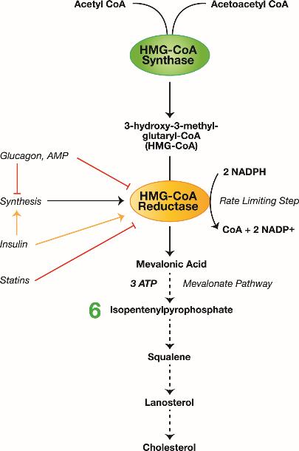
Cholesterol Synthesis
Figure 6.13 Cholesterol Synthesis

Slide 109
HMG CoA Reductase
Rate limiting enzyme for cholesterol synthesis
Insulin increases activity
Most active by 8pm each evening
Statins should be taken after dinner
Allosteric activator: HMG CoA
Allosteric inhibitor: dietary cholesterol
Highest concentration seen in American Indians

Slide 110
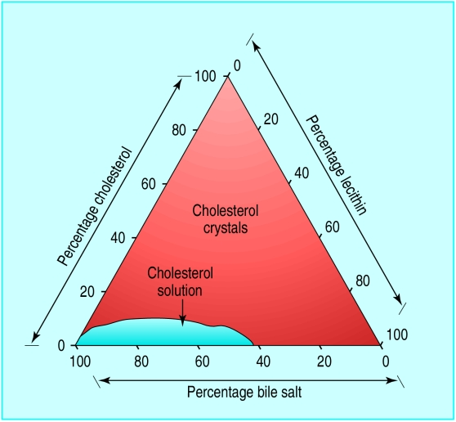
Gallstones

Slide 111
Gallstone Presentation:
RUQ pain after a fatty meal
RUQ colic
Positive Murphy’s Sign

Slide 112
Location of Gallstones
Cystic duct: 90%
Common Bile Duct: 9%
  High alkaline phosphatase
  Increased Temp and increased WBCs
  Gallstone pancreatitis
Ileocecal valve: Gallstone ileus
  Gallstone eroded through the back of the gallbladder
  Fistula between gallbladder and duodenum
  Pneumobilia

Slide 113
Gallstone Terminology:
Cholelithiasis: You have gallstones
Cholecystitis: Inflammation of the gallbladder
Choledocholithiasis: Gallstones in the biliary tract
Cholangitis: Infection of the biliary tree

Slide 114
Cholecystitis
Inflammation of the gallbladder
Management:
  NPO
  IV Normal Saline
  Nasogastric tube
  Meperidine for pain
  IV antibiotics for 48 to 72 hours
  Ultrasound
  Laparoscopic Cholecystectomy

Slide 115
Cholelithiasis/Choledocholithiasis
ERCP for CBD stones
Asymptomatic gallstones should be electively taken out in next two years
MRCP can be done when ERCP is not possible

Slide 116
Gallstone Ileus
Remove gallstone from ileum
Remove fistula from duodenum
Cholecystectomy

Slide 117
Evaluation of Gallstone Disease
Ultrasound: first diagnostic test
HIDA Scan: done if ultrasound is negative
ERCP: done for choledocholithiasis
MRCP: done if ERCP cannot be done

Slide 118
Evidence of High Cholesterol
Xanthomas: fatty pads on extensor tendons
Early coronary artery disease

Slide 119
Cholesterol Screening
Done at age 35 to 40 in adults
Done at age 5 in children who are obese or who have a family h/o obesity or high cholesterol
Get total cholesterol first; if high, then fractionate it
Under 200: Follow annually
Between 200 and 240: diet and exercise for 3 to 6 months
  Treat with meds if two or more risk factors
Above 240: treat everyone

Slide 120
LDL Cholesterol
Baseline:
  Under 70 for diabetic
  Under 100 for general population
Between 100 and 130: diet and exercise for 3 to 6 months
  Treat with meds if two or more risk factors
Above 130: Treat everyone

Slide 121
HDL Cholesterol
Good cholesterol
Independent risk factor for CHD
Keep above 45
  Diet and exercise
  Weight loss
  Moderate alcohol
  Estrogen
  Drug therapy: Niacin

Slide 122
Treatment of High Cholesterol:
Statins:
  Pravastatin
  Lovastatin
  Simvastatin
  Atorvastatin
  Cerivastatin
  Valdestatin
  Rosuvastatin
  Add CoQ if liver enzymes exceed 3X normal or if CPK exceeds 10X normal

Slide 123
Bile Acid Binders
Cholestyramine
Colestipol

Slide 124
PSK-9 Blockers
Evolocumab
These drugs stop the recycling of LDL receptors so that they stay out longer to pull LDL into cells

Slide 125
Urea Cycle
Anabolic and Catabolic
90% occurs in liver
10% occurs in renal collecting duct

Slide 126
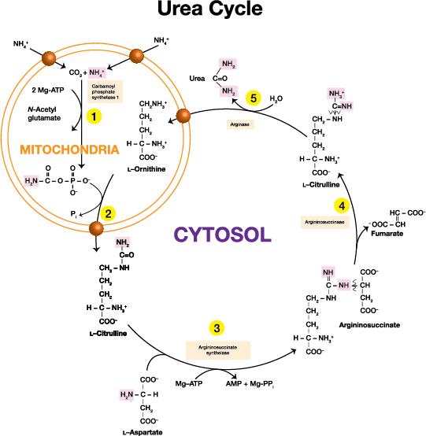
Urea Cycle
Figure 6.15 Urea Cycle

Slide 127
The Renal Collecting Duct 10%
Linear with renal plasma flow, BUN clearance, secretion rate, PAH clearance
Inversely related to serum BUN

Slide 128
GGT
Does 90% of transamination
Located in mitochondria
Amino acid + alpha ketoglutarate = glutamate + carbons
Glutamate holds 90% of urea groups

Slide 129
Glutamate Dehydrogenase
Glutamate + NADH = alpha Ketoglutarate + NH4
Delivers the ammonium ion into the urea cycle

Slide 130
Citrulline
Cyclical Citrullinated peptides (CCP) is now the best marker for rheumatoid arthritis

Slide 131
Rapid Growth Periods
O to 2 years of age
4 to 7 years of age
Puberty

Slide 132
L-Arginine
Not always essential
Essential only during the rapid growth periods
Used to make Nitric Oxide (NO) which is most potent vasodilator
Blacks have the lowest concentration

Slide 133
Urea
One Nitrogen from ammonium
One nitrogen from aspartate
The ketone group from Carbon dioxide
Broken down by urease positive bacteria in GI
Secreted into GI and excreted with feces
NH3 can be reabsorbed if broken off or it can be turned into NH4 with hydrogen
Carbon dioxide is what creates flatus
O
NH₂ –C –NH₂
Urea

Slide 134
Liver Failure
First limit protein intake (source of urea)
Give neomycin to get rid of urease positive bacteria in GI tract
Give lactulose to purge GI of ammonium, which then pulls urea out of blood and brain
Avoid drugs that are metabolized in liver
Avoid long-acting drugs
Avoid drugs that block P450 system
Avoid any drug that enhances GABA

Slide 135
Liver Transplant:
The only thing that can extend the life of someone with liver failure

Slide 136
Glutamine
Made by adding one more urea group to glutamate
Sent to the kidney, who has glutaminase

Slide 137
Hepatorenal Syndrome
Too much GABA
Caused by anything that cause too much acidosis

Slide 138
Nucleotides

Slide 139
Nucleotides
RNA
DNA
Energy
Carriers (UDP & CDP)
Methyl Group Carrier (S-AM)
Second Messengers

Slide 140
UDP Vs Dolichol
UDP: One sugar
Dolichol: Multiple sugars

Slide 141
Purines
Adenine
Guanine

Slide 142
Diseases Related to UV Light
Ecthyma or Ichthyosis
Xeroderma Pigmentosa
Ataxia Telangiectasia
Lynch Syndrome (HNPCC)

Slide 143
PYRIMIDINES
Thymidine
Cytidine
Uracil

Slide 144
Nucleotides
A
G
A
T
C
U

Slide 145
Found Only in DNA
Thymidine

Slide 146
Found Only in RNA
Uracil

Slide 147
To Silence DNA
Methylation
Add G and C

Slide 148
To Loosen Up DNA
Acetylation of Histones

Slide 149
Proofreading DNA
Thymidine Dimers
  UV-light Endonuclease
  Ichthyosis
  Xeroderma Pigmentosa
Free Radical damage
  Ataxia Telangiectasia
Mismatch Repair
  Lynch Syndrome

Slide 150
THE BLOTS
Southern blot: DNA
Northern blot: RNA
Western blot: PROTEIN
PCR: amplifies DNA or RNA
ELIZA

Slide 151
Nucleotides Continued
Euchromatin:
  Loose DNA
  More As and Ts
Heterochromatin:
  Tight DNA
  More Gs and Cs
Purines
Pyrimidines

Slide 152

Purines
Ribose 5 Phosphate + ATP PRPP + GIN? G Phosphoribosylamine
Energy Needed:
2ATP
4ATP
Glycine
Aspartate
Glutamine
CO2
THF
PRPP Synthetase
+
PPi
IMP
Salvage Pathway
PRRP
Hypoxanthine IMP + PPi
HGPRT
PRPP
Guanine GMP + PPi
PRPP
Adenine AMP + PPi
APRT
Xanthine Oxidase
Uric Acid
Pi + GDP GTP ATP AMP + PPi
AMP GMP
ATP ATP
ADP GDP
ATP ATP
ATP GTP

Slide 153
To Make a Purine Ring
9 or 10 ATPs
Glycine
Glutamine
Aspartate
CO2
THF

Slide 154
HGPRT
Rate limiting enzyme for Hypoxanthine and Guanine
Partial Deficiency: Gout in a child
Complete Deficiency: Lesch-Nyhan Syndrome

Slide 155
Gout
Most Effective: Colchicine
First Line: Indomethacin
In Renal Failure: Inject joints with steroids
Chronic or Recurrent: Allopurinol or Febuxostat
To Break up crystals: Rasburicase

Slide 156
Pyrimidines
NH4 + CO2 + 2ATP
CPS-11
Carbamoyl Phosphate
+ PRPP
Orotic Acid
TMP
THF
UMP
GLN
CMP

Slide 157
Carbamoyl Phosphate Synthetase
CPS-1
  Urea Cycle
  Located in mitochondria
CPS-11
  Pyrimidine synthesis
  Located in cytoplasm

Slide 158
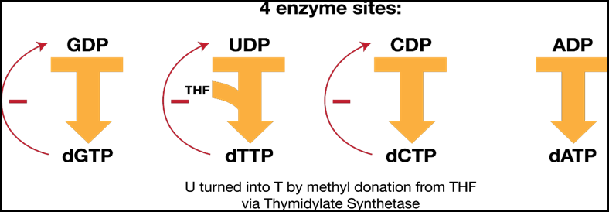
Ribonucleotide Reductase
Figure 6.19 Ribonucleotide Reductase Function

Slide 159
SCID
Adenosine deaminase def
Unable to make DNA
Affects all rapidly dividing cells, especially bone marrow
Bone marrow transplant is now current therapy

Slide 160
SCID Update
Two thirds of cases
X-linked recessive
IL-2 and IL-7 receptor is defective
One third of cases
Enzyme is deficient
Autosomal recessive

Slide 161
The DNA Helix
A Form
(Right-handed helix)
11 bp/turn
B Form
(Right-handed helix)
10 bp/turn
z Form
(Left-handed helix)
12 bp/turn

Slide 162
HISTONES
Help bind DNA helix
H-1
H-2a
H-2b
H-3
H-4
Basic

Slide 163
A Nucleosome
An octamer
Two of each:
  H-2a
  H-2b
  H-3
  H-4

Slide 164
H-1: The Linker protein

Slide 165
Anti-Histone Antibody
Hydralazine Drug-Induced Lupus
INH
Procainamide
Penicillamine
Phenytoin
Ethosuximide

Slide 166
SLE
DsDNA antibodies
  Most diagnostic
  Most nephrotoxic: Tx is Mycophenolate
Anti-SM
Anti-Cardiolipin
  Stimulates intrinsic clotting cycle
  Multiple spontaneous abortions
  Blocks VWF
  False positive VDRL

Slide 167
Drug Induced Lupus: Differences
1. Reversible
2. Different markers
3. No renal involvement

Slide 168
Section Three: Cellular Cycle

Slide 169
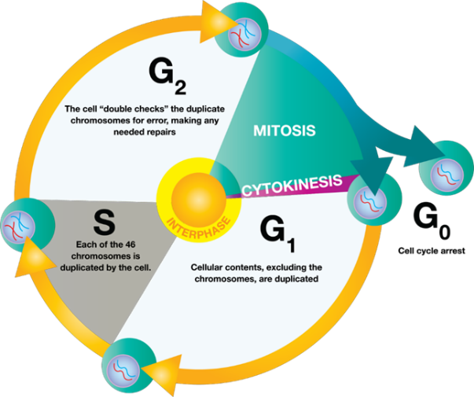
Cellular Cycle
Figure 6.20 Cellular Cycle

Slide 170
Rb-gene
A repressor
Proofreads genes before DNA synthesis
Associated with retinoblastoma and Ewing’s osteosarcoma

Slide 171
Centrioles
ONLY proteins made during the S-phase

Slide 172
Apoptosis
P-53: The gene
D-Cyclins: The proteins
Phosphatidylserine: The label
Caspaces: Bind the label and digest the cell
Ubiquitin: The label for proteins
Ubiquitin Ligase: Places the label

Slide 173
Mitosis
Interphase
Prophase
Metaphase
  Microtubules are made
Anaphase
  Nondisjunction
Telophase

Slide 174
DNA Replication
DNA-A Protein
SSB Proteins
Helicase
Primase
DNA Polymerase 3
  5-3 Polymerase/3-5 Exonuclease
DNA Polymerase 1
  5-3 Exonuclease/5-3 Polymerase/3-5 Exonuclease
DNA Ligase
Topoisomerase

Slide 175
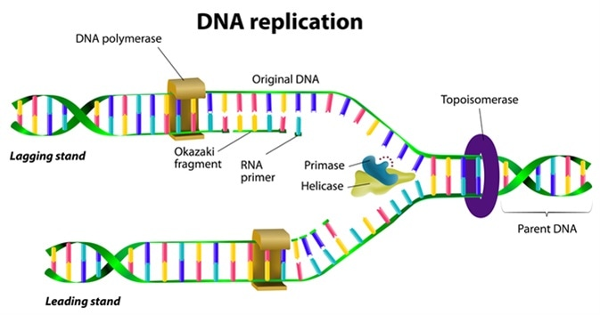
DNA Replication
Image Source: https://www.news-medical.net/life-sciences/DNA-Replication-and-Repair.aspx

Slide 176
What if you had fewer than 8 bases left on the 5’-3’ lagging strand ?
Telomerases: add 30 to 40 nonsense nucleotides
  Remove these bases before copying is done

Slide 177
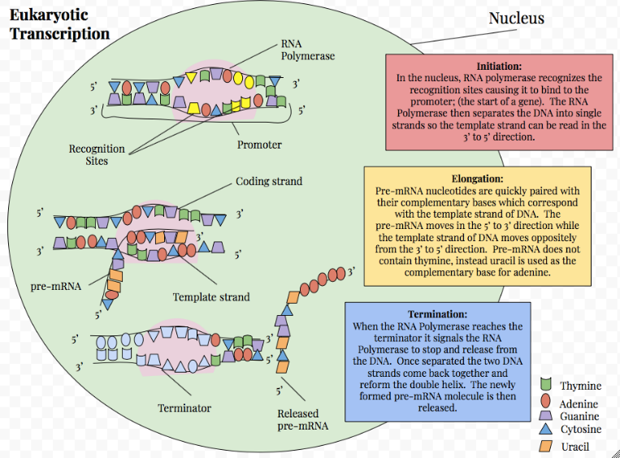
Transcription
https://en.wikipedia.org/wiki/Eukaryotic_transcription#/media/File:Eukaryotic_Transcription.png

Slide 178
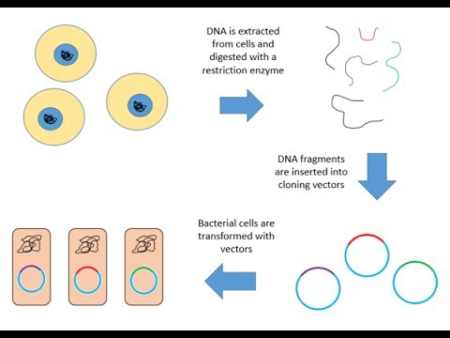
Genomic Library
Image Source: https://www.youtube.com/watch?v=SnmMhYnINj0

Slide 179
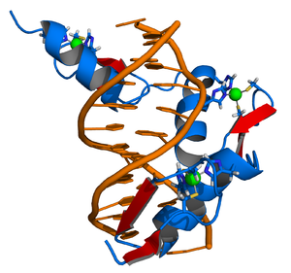
Zinc Fingers
Image Source: https://en.wikipedia.org/wiki/Zinc_finger#/media/File:Zinc_finger_DNA_complex.png

Slide 180
RNA Polymerase
Alpha, beta, beta prime: Core enzyme
ADD Sigma factor, rho factor: Holoenzyme
Rifampin
Fidaxomicin
Anti rho antibody

Slide 181
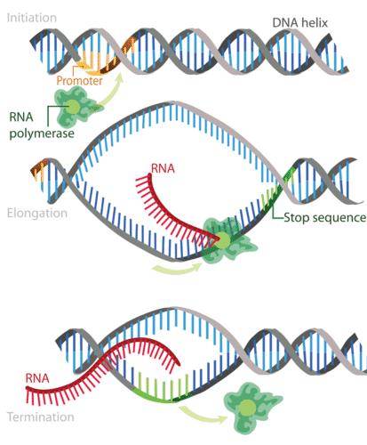
Transcription
Image Source: https://www.news-medical.net/life-sciences/DNA-Replication-and-Repair.aspx

Slide 182
Transcription Initiation
Minus 35 sequence
  Recognized by the core enzyme
Minus 10 sequence
  Recognized by the sigma factor

Slide 183
Transcription Process
NOT continuous
Exons: will be expressed
Introns: intervening sequences

Slide 184
Transcriptional Termination
Palindrome: termination sequence
  RACECAR
Rho-dependent transcriptional termination

Slide 185
Post-Transcriptional Modification
SnRNPs
  Splice off introns
  Bring exons together: gene now continuous
  Add poly A tail to 3’-end
  Add Guanosine to 5’-end: capping
  Move unit to cytoplasm
  P-bodies grab unit
  A methyl group is added to C-7 of guanosine
  mRNA now attaches to 30s ribosome
  Anti-RNP antibody

Slide 186
Lessons from the Lac Operon
Repressor
Enhancer
Gain of function enhancer mutations:
  BCL-2
  KRAS
  Jun
Loss of function repressor mutation
  Any cancer that occurs from birth to 21y/o
Initiator and Promoter mutations: 2 hit theory

Slide 187
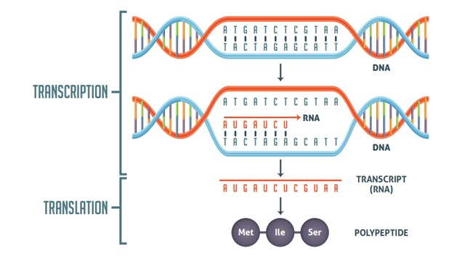
Transcription vs. Translation
Image Source: https://www.news-medical.net/life-sciences/DNA-Replication-and-Repair.aspx

Slide 188
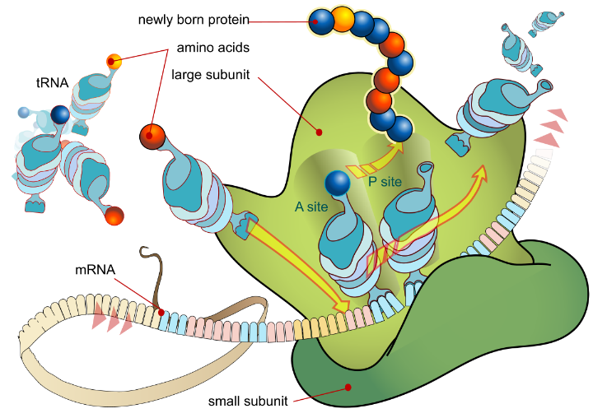
Translation
Image Source: https://en.wikipedia.org/wiki/Translation_(biology)#/media/File:Ribosome_mRNA_translation_en.svg

Slide 189
The Players

Slide 190
RNA
rRNA – from nucleolus; most abundant RNA polymerase 1 replicates it
mRNA –
  RNA polymerase 2 replicates it
tRNA and SnRNPs
  RNA polymerase 3 replicates it

Slide 191
tRNA
64 different ones
Start codon: AUG
Stop codons: UAA, UAG, UGA
60 codons left for 20 amino acids
CCA : on 3’-end
  Amino acid attached to the A

Slide 192
30s Ribosome
Shine-Dalgarno sequence: where mRNA binds
Initiation factors: IF-1, IF-2, IF-3
  Aminoglycosides: block initiation factor
  Tetracyclines: block tRNA from binding

Slide 193
A-Site
Amino acid is dropped off here
Puromycin: blocks this site

Slide 194
P-Site
Where the peptide bond is made

Slide 195
Start Codon
Methionine is dropped off

Slide 196
50s Ribosome
Elongation factor: EF-1, EF-2, EF-3

Slide 197
EF-2
Reads codon
Finds the correct tRNA with amino acid
Brings correct tRNA to A-site

Slide 198
Inactivates EF-2
Corynebacterium Diphtheria
Pseudomonas Aeruginosa

Slide 199
The Process
EF-2 drops off amino acid
Peptidyl transferase makes peptide bond with last amino acid
  chloramphenicol
Translocase moves three bases to next codon
  Clindamycin/Lincomycin
  Macrolides

Slide 200
The Cost
Activation: 2 GTP attaching amino acid to tRNA
EF-2 transports tRNA over to mRNA: 1 GTP
Translocation: 1 GTP
Total energy needs: 4 GTP/amino acid added

Slide 201
Differences
DNA Replication
  DNA POL alpha (Primase)
  DNA POL beta (DNA pol 1)
  DNA POL gamma (Mitochondrial DNA)
  DNA POL delta (Leading strand)
  DNA POL epsilon (Lagging strand)
  Replication forks
Transcription
  Monocistronic
  Polycistronic
Translation
  Fmet vs Met

Slide 202
Mutations
Frameshift mutations
Point mutations
  Transition mutations
  Transversion mutations
    Silent mutations
    Missense mutations
    Nonsense mutations

Slide 203
Can it be the END?
YES, IT IS!!!

Slide 204
Or is It?

